Slide 1
PRASANNAKUMAR C
BE -COMPUTER SCIENCE AND ENGINEERING
SIR ISAAC NEWTON COLLEGE OF ENGINEERING AND TECHNOLOGY

Slide 2
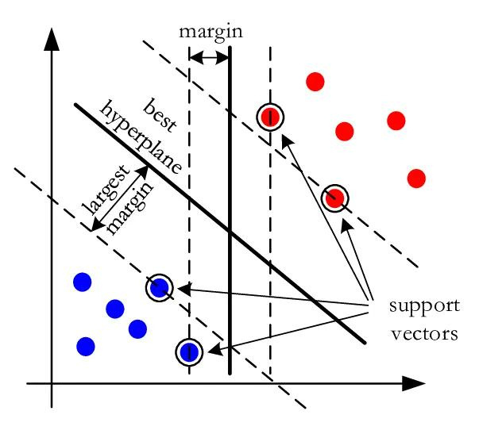
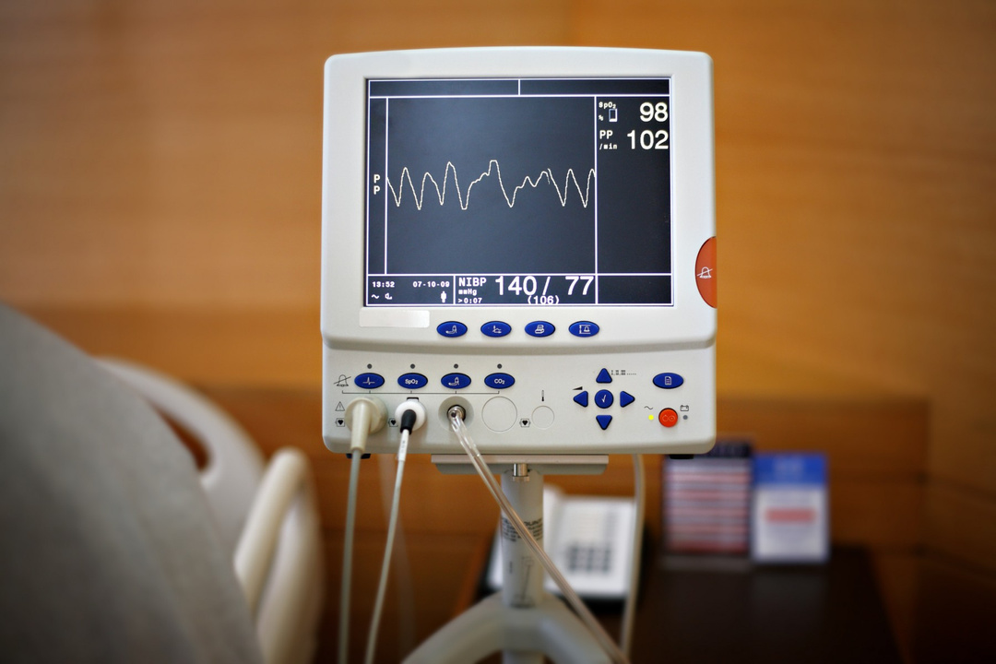
HEART FAILURE PREDICTION USING ARTIFICIAL NEURAL NETWORK

Slide 3
AGENDA
our end-to-end heart disease prediction tutorial aim to detect the presence or risk of heart disease in the person based on their medical attributes. For this, we use a representative data set from sources such as UCI's repository that includes medical histories and attribute information for several patients. Moreover, data processing, exploratory data analysis, and some data visualization bring out new insights from a medical dataset.

Slide 4
PROBLEM STATEMENT
In this project, our objective is to develop an artificial intelligence-based predictive model using Artificial Neural Networks (ANN) to accurately identify individuals at risk of heart failure. By leveraging various demographic, clinical, and diagnostic features, we aim to build a robust predictive tool that can assist healthcare professionals in early identification and proactive management of individuals susceptible to heart failure.

Slide 5
PROJECT OVERVIEW
Heart failure is a critical medical condition that affects millions of people worldwide. Predicting the likelihood of heart failure in patients can significantly enhance early detection, intervention, and management strategies, ultimately improving patient outcomes and reducing healthcare costs.
Data Collection
Data Preprocessing
Feature Selection and Engineering
Model Selection
Model Training and Validation
Model Interpretation

Slide 6
Who are the end users?
The end users of the heart failure prediction project may include:
Healthcare Providers
Hospitals and Healthcare Facilities
Patients
Healthcare Administrators and Policy Makers
Research Community

Slide 7
Your solution and its value proposition
Our solution is a comprehensive heart failure prediction model developed using advanced machine learning techniques and leveraging rich clinical data and patient demographics. By analyzing key indicators and risk factors associated with heart failure, our model accurately predicts the likelihood of individuals developing this critical medical condition.
Early Detection and Intervention
Personalized Patient Care
Enhanced Patient Outcomes
Empowering Patients

Slide 8
The wow in your solution
the WOW factor of our solution lies in its ability to revolutionize heart failure care through proactive risk management, precision medicine, real-time decision support, scalability, continuous improvement, patient empowerment, and collaborative innovation. By harnessing the power of technology and data-driven insights, we are transforming the landscape of cardiovascular health and setting new standards for patient-centered care.

Slide 9
Modelling
this modeling approach, we can develop a robust and accurate predictive model for heart failure, enabling proactive risk assessment, personalized patient care, and improved clinical outcomes.
Once the final model is trained and validated, deploy it into a production environment for real-world use. Implement the model as a software application, API, or integrated module within existing healthcare systems.

Slide 10
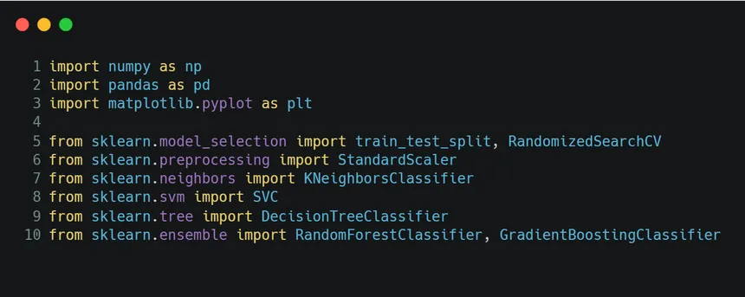
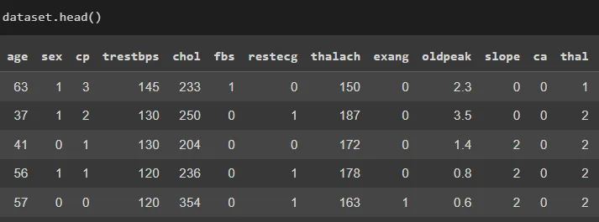
DATA VIRTUALIZATION

Slide 11
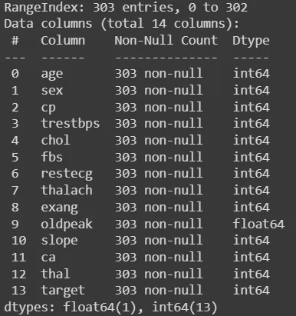

Slide 12
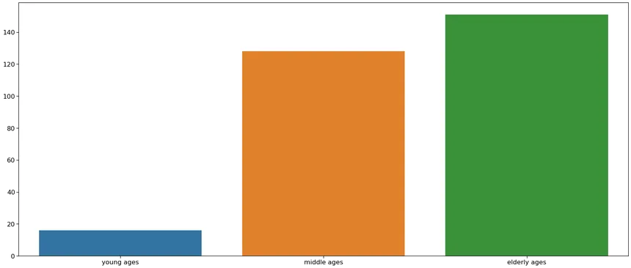

Slide 13
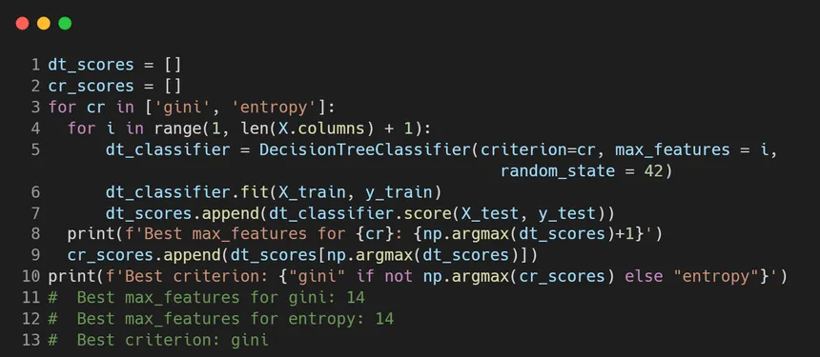
sample program :

Slide 14
THANKING YOU !!!

